Slide 1
A Session of counseling
Communication in marriage for xxx
Counselor Ming
8-17-2021

Slide 2
You don’t need more communications, nor faster....
You need better communication.

Slide 3
What are two elements of communication?

Slide 4
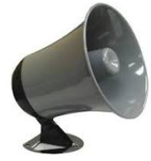
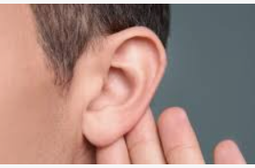
Speaking
Listening

Slide 5
with pauses
Right:
Thinking
speaking
listening.
Thinking
speaking
listening.
Wrong:
speaking speaking angry

Slide 6
Think before you speak; and think after you listen.

Slide 7
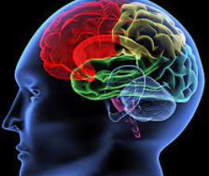
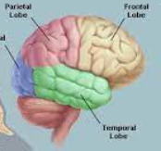
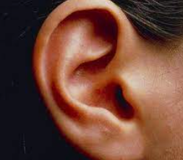
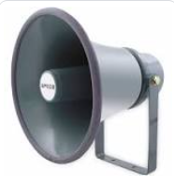
speaking is not short-circuit reflex.
Speaking
Listening

Slide 8
listen speak angry
James 1:19-20 19 My dear brothers and sisters, take note of this: Everyone should be quick to listen, slow to speak and slow to become angry, 20 because human anger does not produce the righteousness that God desires.
brain quickly process information
mouth and tongue slowly
pronounces information

Slide 9
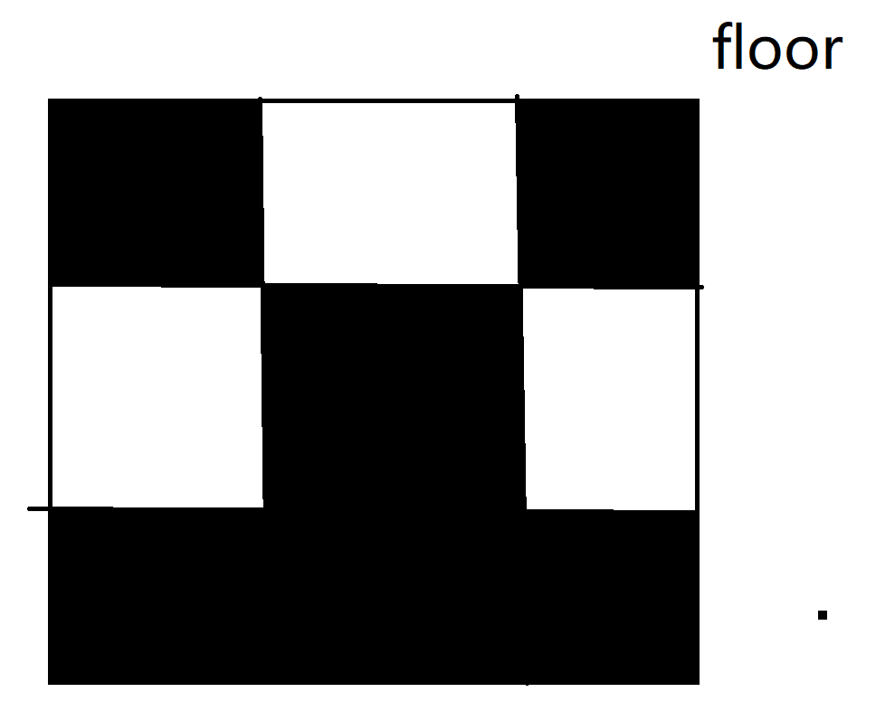
Hold the floor method.
creat a phyical card
have one party to star first,
ladies first.
hold the card, start the timer for 3min, no more than 3min,
transfer the card and get feedback for the other part.
rule is when some one is hold the floor , the card, no other persons can interupt.
holding the floor can not be too long.

Slide 10
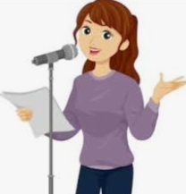
Which one goes first? Who goes first?
Speaking
Listening
Lady

Slide 11
Respect your wife and thus each other
25 Husbands, love your wives, just as Christ loved the church and gave himself up for her 26 to make her holy, cleansing[b] her by the washing with water through the word, 27 and to present her to himself as a radiant church, without stain or wrinkle or any other blemish, but holy and blameless. 28 In this same way, husbands ought to love their wives as their own bodies. He who loves his wife loves himself.

Slide 12
angry: did not listen or listened wrongly
James 1:19-20 19 My dear brothers and sisters, take note of this: Everyone should be quick to listen, slow to speak and slow to become angry, 20 because human anger does not produce the righteousness that God desires.

Slide 13
speaking is not short-circuit reflex.
Speaking
Listening

Slide 14
Thank you for your attention!
God bless!

